Slide 1
FREE TIME Activities
7° grades
Miss Pamela Roky
Miss Francisca Ipinza

Slide 2
Instructions
Hi!
Use your notebook to write and draw the following exercises.
Send your photos to Miss Pamela (Pamela.roky@elar.cl )
Or Miss Francisca
(francisca.ipinza@elar.cl) where corresponds.

Slide 3
Likes and dislikes
Watch this video related to Likes
and Dislikes
*Remember:
I – You – We - They Like
She- He – it
Likes

Slide 4
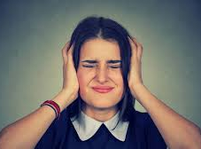
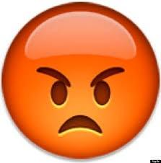
Other ways to say I like – I Dislike…
Love
Enjoy
Prefer
Can’t stand
Hate
I love to eat Chocapic
I enjoy watching “La casa de Papel”
I hate broccoli
I prefer Ice Cream than “Lentejas”
I can’t stand pinapple pizza

Slide 5
1. Look at these sentences and put the emoji/ image to the correct sentence
a. I dislike going to the cinema.
b. I prefer to take it easy with friends.
c. I love to study!
d. They hate playing basket the summer.
e. Do you like reading?
f. I can’t stand watching TV.
g. Manuel enjoys skateboarding.

Slide 6
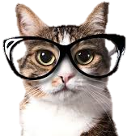
Here we have some hobbies/ activities
What are your favorite free time activities?
In my free time
I like to read

Slide 7
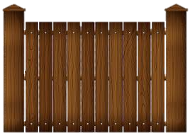
What do you do in your free time?
In my free time I like to…
Watch the video and write the activities that she likes to do.
Activities
1. Play the guitar
2.
3.
4.
5.
6.
7.
8
9.
10.

Slide 8
2. Answer these questions about you
What are your favorite free time activities?
What are the most popular activities between your friends?
How do you feel when you do your free time activities? Express your feelings.
Choose the most common free time activity between your friends and describe it.

Slide 9
3. A poster…
You are going to create a poster about the most common free time activities between your friends. Think of a tittle for your work.
Play Judo!
*Tip: you can do it in your notebook and send your photo to your teacher email
Is good for your health.
Your health will improve

